Slide 1

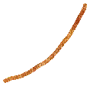

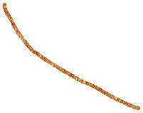
Cirsium heterophyllym & Cirsium oleraceum
They smell different, also, tissues smell different.

Slide 2
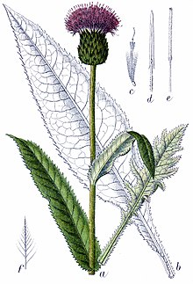
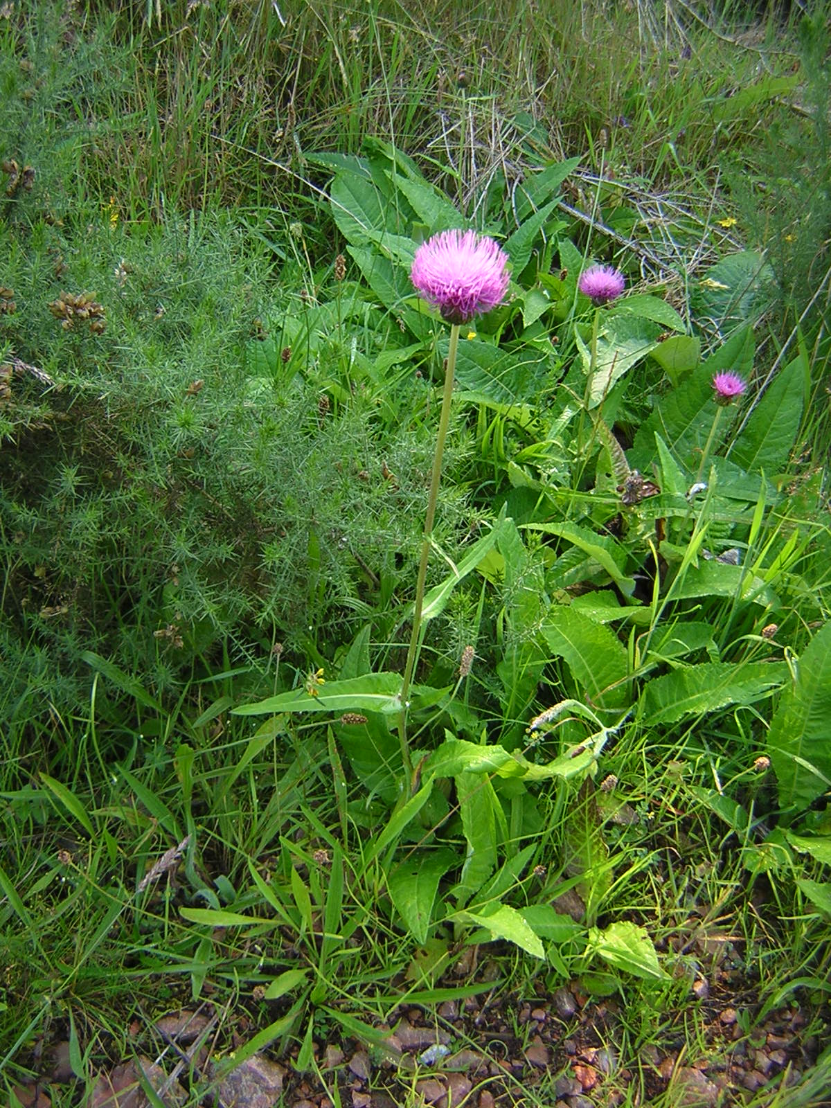
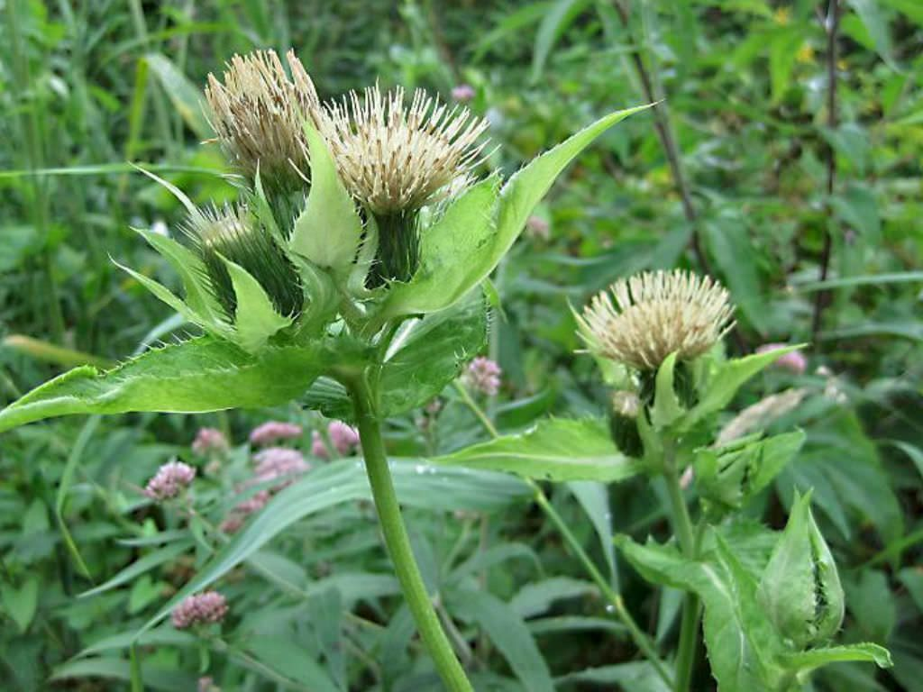
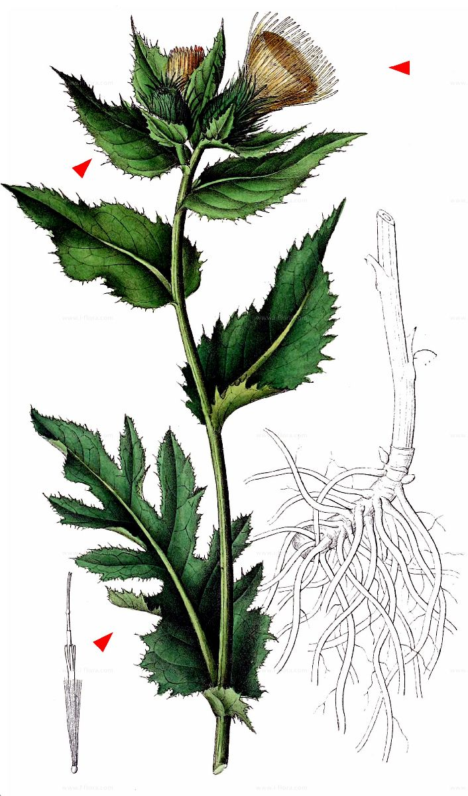
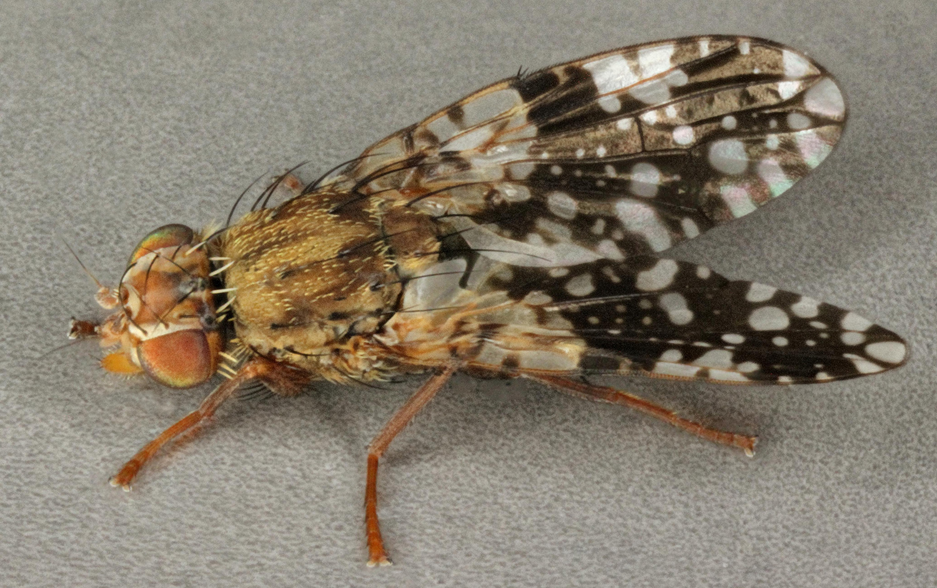
Background
Tephritis conura
C. Heterophyllum (ancestral)
C. oleraceum

Slide 3
Scent
Is there any difference between the two host plant species?
Buds – this is where the fly drills its way in and oviposits
Flowers – long distance attraction to plant?
Leaves – defense/vegetative control

Slide 4
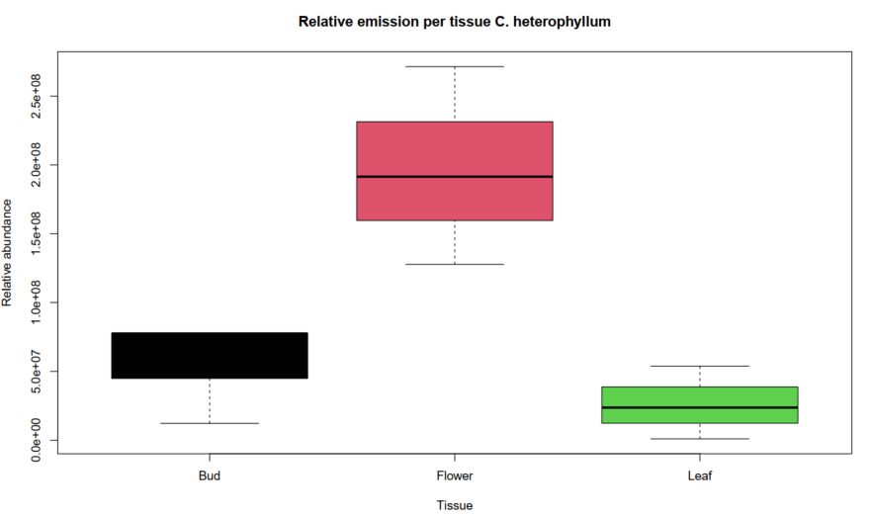
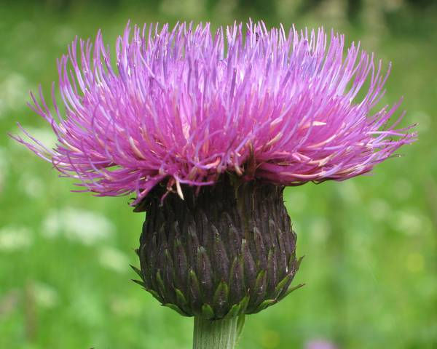
C. heterophyllum
p= 0.0116 *
Less than flower

Slide 5
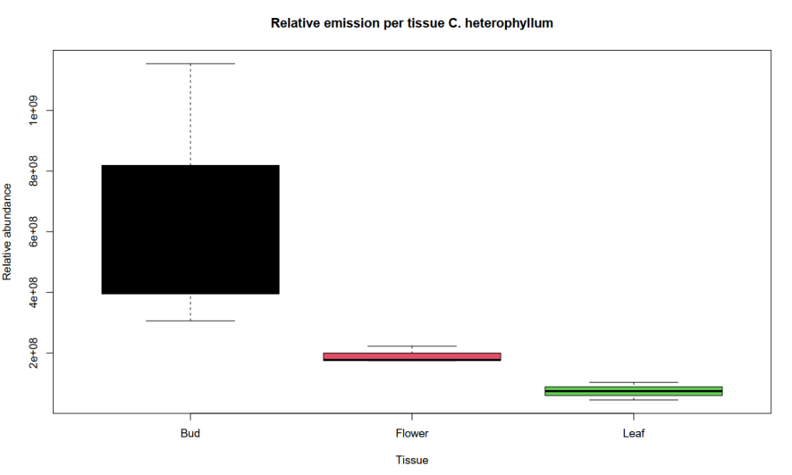
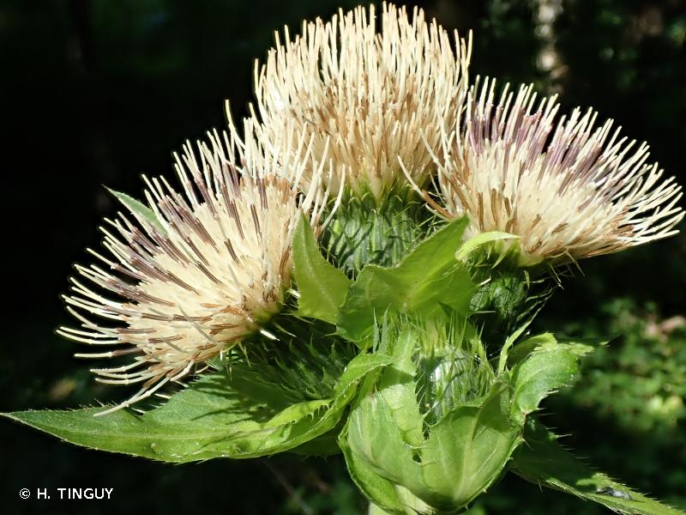
C. oleraceum
A LOT more in general
p =0.0752
More than flower

Slide 6
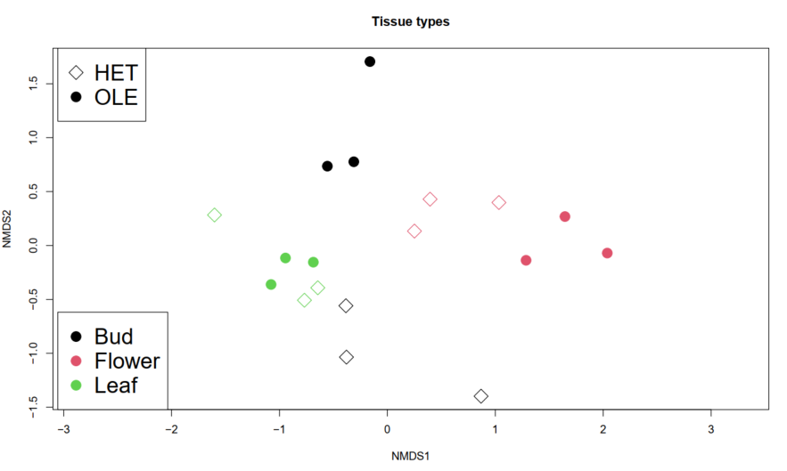
Compositions
p = 1e-04***
Stress: 0.15
Ole bud
Flowers
Leaves
Het bud

Slide 11
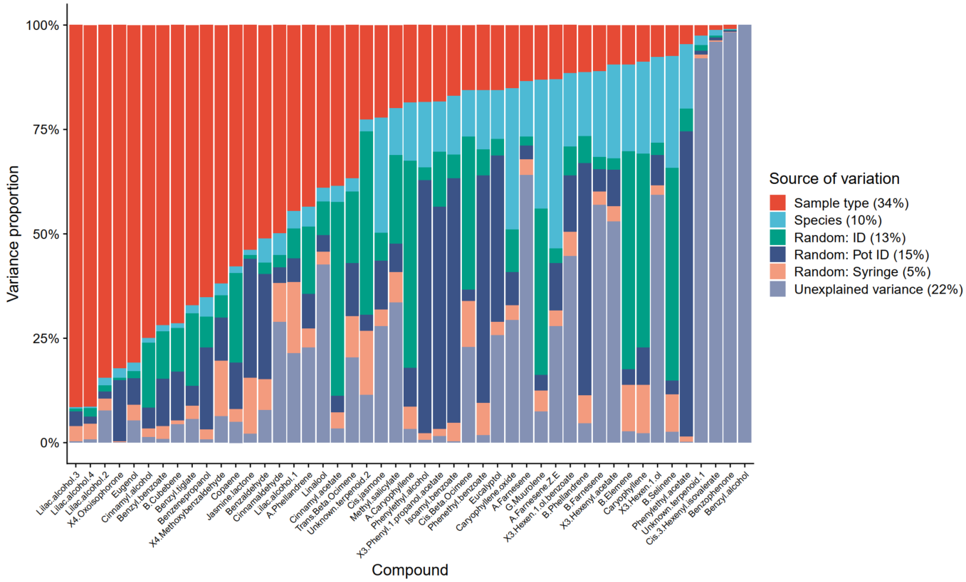
Variance partitioning (both species)

